Slide 1
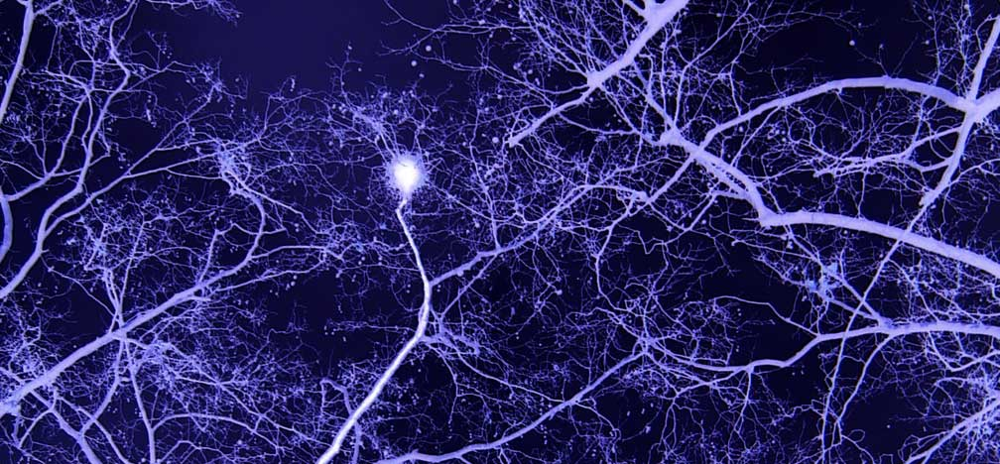
Neural circuits
CNS contains billions of neurons organized into complicated networks called neural circuits.
These are functional groups of neurons that process specific types of information.
The simplest neural circuit may consist of one series connection, but in most cases they are very complex.
These are not branches of trees, but neural circuits of our brain …

Slide 2
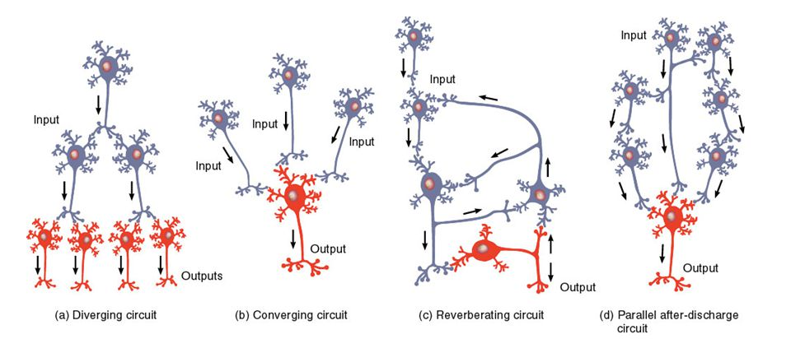
Neural circuits: types

Slide 3
Definitions
Diverging – A single presynaptic neuron may synapse with several postsynaptic neurons.
Example: Sensory signals are arranged in diverging circuits, allowing a sensory impulse to be relayed to several regions of the brain. This arrangement amplifies the signal.
Converging – Several presynaptic neurons synapse with a single post synaptic neuron. This arrangement permits more effective simulation or inhibition of the postsynaptic neuron.
Example: A single motor neuron that synapses with skeletal muscle fibres at neuromuscular junctions receives input from several pathways that originate in different brain regions.
Reverberating – Branches from later neurons synapse with earlier ones, thereby sending impulses back through the circuit again and again.
Example: The activities of breathing and waking up are considered to be a result of such circuit.
Parallel after-discharge – A single presynaptic cell stimulates a group of neurons, each of which synapses with a common postsynaptic cell.
Example: Mathematical calculations.

Slide 4
Plasticity and Regeneration
The nervous system exhibits capabilities to change based on experience. This property of the neurons is called plasticity. This changes may include sprouting of new dendrites, synthesis of new proteins, and changes in synaptic contacts with other neurons. Both chemical and electrical signals drive these changes.
The regeneration of neurons is the capability to replicate or repair themselves. Mammalian neurons have limited capacity to regenerate. In PNS, damage to dendrites and axons may be repaired to certain extent if the cell body and the Schwann cells remain active. However, CNS exhibits little or no repair to the damage.

Slide 5
Artificial Neural Network (ANN)
An artificial neuron network (ANN) is a computational model based on the structure and functions of biological neural networks. Information that flows through the network affects the structure of the ANN because a neural network changes - or learns, in a sense - based on that input and output.
ANNs are considered nonlinear statistical data modelling tools where the complex relationships between inputs and outputs are modelled or patterns are found.
ANN can actually learn from observing data sets. In this way, it is used as a random function approximation tool.
Training an artificial neural network involves choosing from allowed models for which there are several associated algorithms.
Usage: Machine Learning, Artificial Intelligence

Slide 6
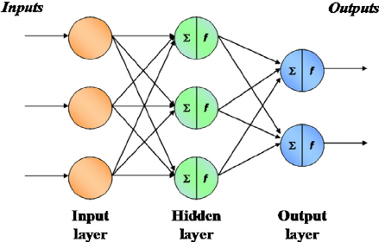
Structure of ANN
Backpropagation, short for "backward propagation of errors," is an algorithm for supervised learning of artificial neural networks using gradient descent. Given an artificial neural network and an error function, the method calculates the gradient of the error function with respect to the neural network's weights.

Slide 7
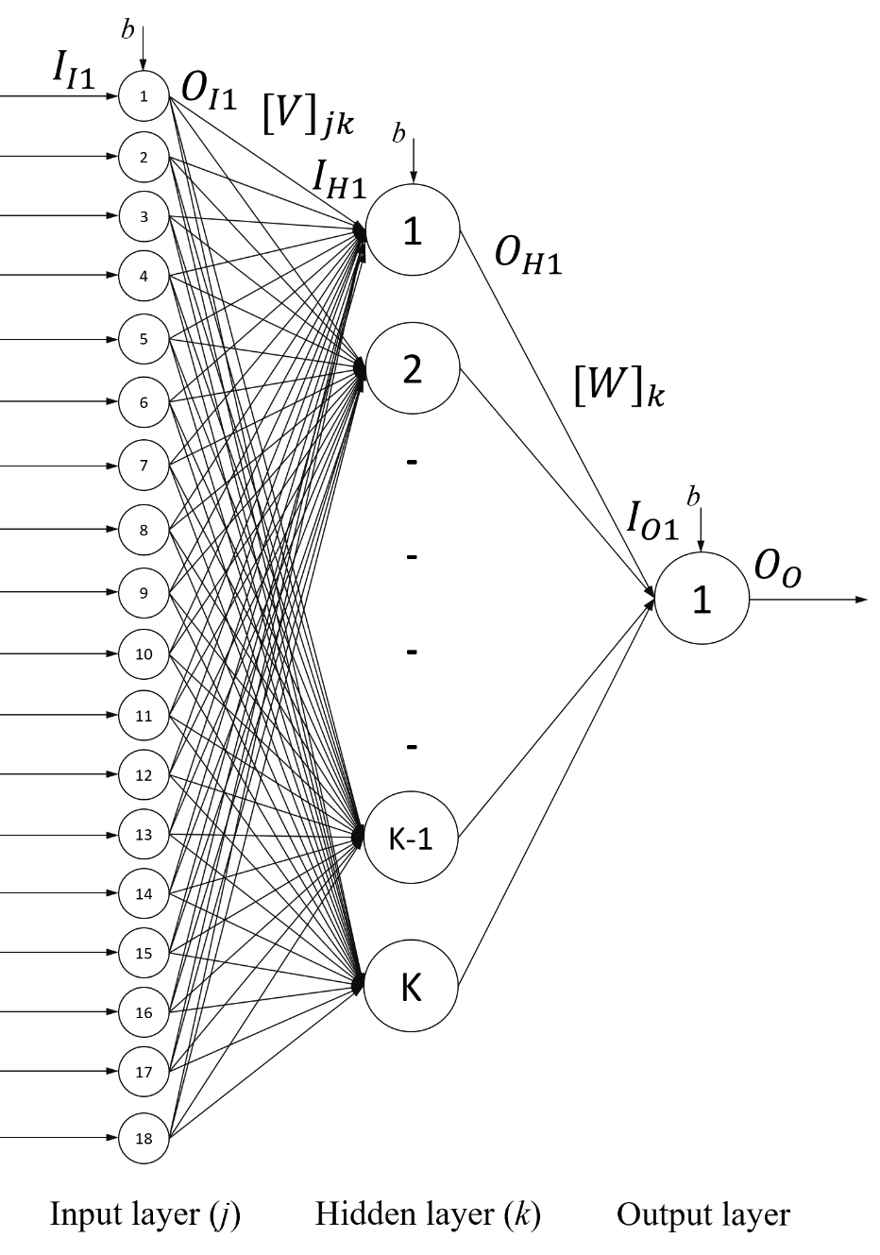
Back-propagation Neural Network (BPNN)
a1: constant of activation function for input neurons
a2: constant of activation function for hidden neurons
a3: constant of activation function for output neurons
b: bias value

